Slide 1


BASIC PRINCIPLES OF PROJECT MANAGEMENT
Lecturers : Prof. Nguyễn Văn Hùng
Assoc. Prof. Nguyễn Hải Đăng
Dr. Nguyễn Tường Lan
MSc. Nguyễn Lâm Cường
Assistant Lecturer :
Ms: Đỗ Hoàng Yến
Academic Year: 2025-2026

Slide 2
Highlights of Lecture 2
Chapter 2 : General Knowledge of Project
- Definition of Project Nowadays
- Characteristics of Projects
- Preparation of Project ( Steps )
- The reasons for the success or failure of projects.

Slide 3
General Definition of a Project
A project is a type of assignment, typically involving research or design, that is carefully planned to achieve a specific objective. An alternative view sees a project managerially as a sequence of events: a "set of interrelated tasks to be executed over a fixed period and within certain cost and other limitations".
Assignment /əˈsaɪnmənt/ sự giao việc , sự phân công
a task or piece of work that somebody is given to do, usually as part of their job or studies

Slide 4
PHONG CHAU BRIDGE
Phong Chau Bridge inaugurated after nine months of emergency construction
Sunday, 16:21, 28/09/2025
VOV.VN - The Ministry of Construction and the People’s Committee of Phu Tho province on September 28 inaugurated and opened to traffic the new Phong Chau Bridge on National Highway 32C.
Construction of the new bridge began on December 21, 2024, and was completed three months ahead of schedule. The bridge is more than 652 meters long and 20.5 meters wide, designed with four traffic lanes. The project had a total investment of over VND635 billion and was managed by the Thang Long Project Management Board under the Ministry of Construction.

Slide 5
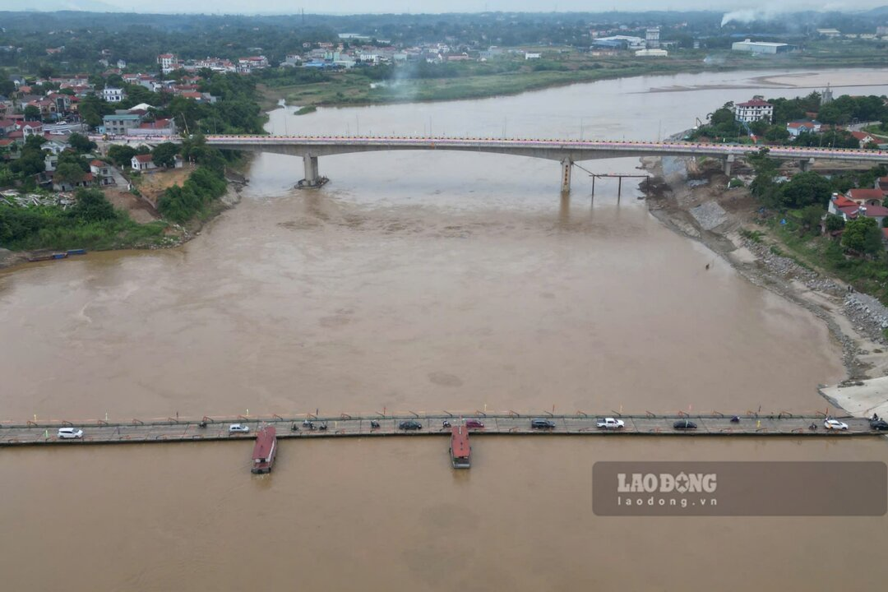
Cầu Phong Châu khánh thành 9/2025

Slide 6
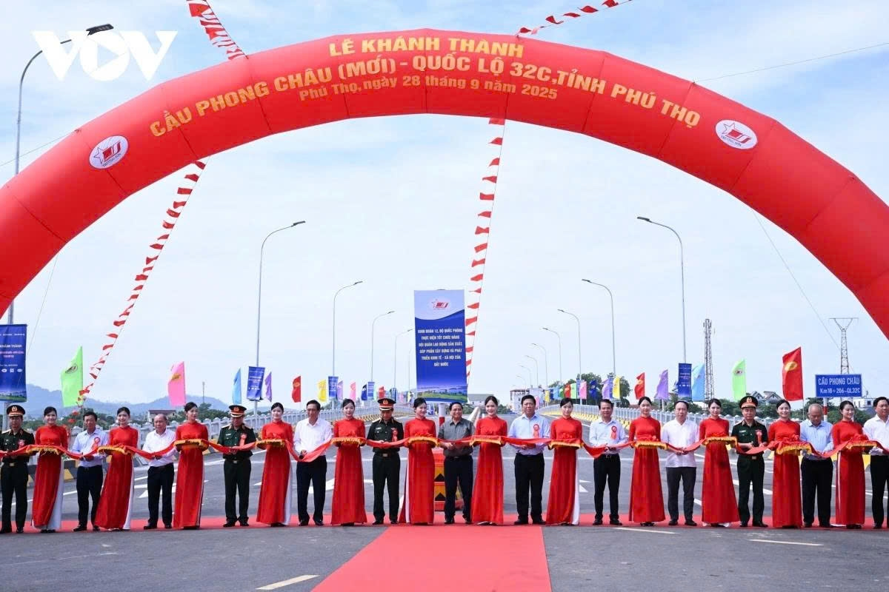

Slide 7
The Government completed the target of 334,000 new temporary houses, HDBank joined hands to contribute over 2,600 houses
At the national online conference summarizing the program "The whole country joins hands to eliminate temporary and dilapidated houses in 2025" organized by the Government Office, HDBank was honored to receive a Certificate of Merit from the Prime Minister in recognition of its outstanding contributions to social security and community development.

Slide 8
Lecture 3
Chapter 3
Types of Projects :
- Classification of Projects
- Representative Project Examples

Slide 9
Types of Projects
There are the different basis to classify the projects.
The projects in the world depend on how you define "project" and what category you're looking at .

Slide 10
A . Classification of Projects

Slide 11
There are the different basis to classify the projects.
Projects can be classified as under:
1. Based on the following fundamentals:
1.1 Long term (Years)
Broad Goals (A company’s large scale objectives. I.E; Improve ROI, Increase Shareholder value, Gain market share etc…)
Setting global business or strategic goals such as your release criteria, workflow setup and lifecycle?
Selecting and assigning which resources are allocated to which projects (What team resources can I allocate? What can I afford to dedicate to this project?)
1.2 Short term (Months)
- Specific Objectives (Hitting Milestones and Release Dates-Micromanaging the day to day - goals and activities, focusing on execution.
People: Assigning individuals or teams with domain expertise to specific actions.
ROI là viết tắt của Return on Investment : lợi tức đầu tư hoặc tỷ suất hoàn vốn
Assignment : sự giao việc, phân công, hoặc một nhiệm vụ được giao .

Slide 12
Vocabulary
Concepts and meanings should be differentiated :
Goal
Aim
Purpose
Objective
Target

Slide 13
2.The projects can be classified as:
2.1 Strategic Project
A strategic project has a primary goal of gaining the competitive advantage by focusing on the organization's overall direction.
2.2 Tactical project
These are projects that have one operational goal, which probably does not entail contributions by most employees within the organization. In these projects, meeting a tactical goal on time and within budget are key considerations.
Strategic /strəˈtiːdʒɪk/ done as part of a plan that is meant to achieve a particular purpose or to gain an advantage; chiến lược
tactical/ˈtæktɪkl/ connected with the particular method you use to achieve something; chiến thuật
Entail /ɪnˈteɪl/ ​to involve something that cannot be avoided; bắt phải, đòi hỏi

Slide 14
Classification of Projects, continued
    - A Goal is an achievable that is generally broad and longer term .
- Aim : What you hope to get and you want to do this .
- Purpose can be called as the reason on one Aim to achieve a goal
- Objective is shorter term and defines measurable action to achieve overall goal
- Target : the exact results of what you want to get

Slide 15
3. According to the source of fund
3.1. Private sector project
The private sector bodies are responsible for the development and sponsor of the project. Examples: Mall ( shopping areas ), Apartments etc.
3.2. Government sector project
In developing country government is the major sponsor of projects. These are the basis of government developing plans. Examples- Road construction, school, health etc.
3.3. Grant project
Investment in grant projects is not repaid by the government to the donor agencies.
3.4. Loan project
Investment in loan projects is repaid by the government to the donor agencies.
– ADB USTH – project – Building of Hoa Lac compus for USTH.
Sector : khu vực , lĩnh vực

Slide 16
4. According to foreign aided project
4.1. Joint venture project
The project is funded through the collaboration of foreign and local investors. They are based on ownership sharing. Also, they involve transferring of capital, technology, management. Example- Maruti-Suzuki.
4.2. Bilateral project
The project is funded from the financial resources of the friendly donor country. Examples- JICA, KOICA.
USTH (Viet Nam – France University)
4.3. Multilateral project
This project is funded from the financial resources of multilateral agencies such as World Bank and Asian development bank. They are generally funded through loans. All UN agencies are multilateral.

Slide 17
5. According to Techniques
Labor intensive project
This project is labor based. Human labors are extensively used for implementation of the project.
Advantages
More employment generation.
Utilization of resources.
More production at the cheaper rate.
Disadvantages
It cannot be applied for the long run.
No possibility of improving skills.
Low capital formation.

Slide 18
5.2. Capital Intensive Project
This project is technology based. Technology represented by machinery and computerization is extensively used for implementation of the project.
Advantages
Applied for the long run.
Technology transfer.
Ease in capital formation.
Disadvantages
Required huge amount of capital.
Imbalance distribution of income in society.
Centralization.
Capital ???

Slide 19
6. According to function
6.1. Disaster prevention projects.
It is not feasible to formulate universally acceptable definition of disaster prevention project that will satisfy all practitioners, but common and agreed upon definitions must be formulated in the various fields and areas concerned with disasters and where there exit reconcilable, common sets of objective.
Example: Disaster prevention project for sustainable /səˈsteɪnəbl/ project.
Disaster /dɪˈzɑːstə(r)/ prevention projects ???

Slide 20
6. According to function
6.2. Development project
Community Development project
* Abstract
The development objective of the Community Development Project is to establish an effective and sustainable instrument to improve the living conditions and the economic status of disadvantaged communities.
There are two main project components.
6.2.1 The first component focuses on social and infrastructure development and provides sub-project grants for:

Slide 21
+ carrying out social assessments and designing programs of sub-projects
+ implementing sub-projects consisting of:
a) improving access to basic education, health, and social services by rehabilitating and upgrading schools and health, youth, cultural, and recreation centers and facilities in poor areas;
b) carrying out programs for revolving school textbooks, literacy, and primary health care;
c) improving access to specialized social services to satisfy the needs of vulnerable groups at risk;
d) developing basic rural/ˈrʊərəl/ infrastructure activities such as community potable water and small drainage and irrigation schemes; and
e) enhancing environmental protection initiatives such as reforestation and natural resource and cultural heritage ˈherɪtɪdʒ/preservation.
6.2.2 The second component focuses on income enhancement by funding capacity building activities to support:
a) micro and small entrepreneurs and nongovernmental organizations providing credit to target beneficiary groups;
b) women, youth, and disabled people to provide them with demand-driven specialized skills that will help them increase income and business opportunities
disable /dɪsˈeɪbl/ to injure or affect somebody permanently so that, for example, they cannot walk or cannot use a part of their body; vô hiệu hóa
injure/ˈɪndʒə(r) làm tổn thuong
disabled /dɪsˈeɪbld / bị tổn thuong
        Humanity /hjuːˈmænəti/ !!!

Slide 22
* Example
Official development assistance (ODA) is a term coined by the Development Assistance Committee (DAC) of the Organization for Economic Co-operation and Development (OECD) to measure aid. The DAC first used the term in 1969. It is widely used as an indicator of international aid flow. It includes some loans.
Definition
The full definition of ODA is:
Flows of official financing administered with the promotion of the economic development and welfare of developing countries as the main objective, and which are concessional in character with a grant element of at least 25 percent (using a fixed 10 percent rate of discount). By convention, ODA flows comprise contributions of donor government agencies, at all levels, to developing countries (“bilateral ODA”) and to multilateral institutions. ODA receipts comprise disbursements by bilateral donors and multilateral institutions.
Donor /ˈdəʊnə(r)/ bên tài trợ
Recipient /rɪˈsɪpiənt/ bên nhận tài trợ

Slide 23
Official Development Assistance (ODA)
In other words, ODA needs to contain the three elements:
  -undertaken by the official sector (official agencies, including state and local governments, or their executive agencies) with promotion of economic development and welfare as the main objective; and
  at concessional financial terms (if a loan, having a grant element of at least 25 per cent).
This definition is used to exclude development aid from the two other categories of aid from DAC members:
- Official Aid (OA):
Flows which meet conditions of eligibility for inclusion in Official Development Assistance (ODA), other than the fact that the recipients are on Part II of the Development Assistance Committee (DAC) List of Aid Recipients.
- Other Official Flows (OOF): Transactions by the official sector with countries on the List of Aid Recipients which do not meet the conditions for eligibility as Official Development Assistance or Official Aid, either because they are not primarily aimed at development, or because they have a grant element of less than 25 per cent.

Slide 24
NGOs project definition
A non-governmental organization (NGO) is a non-profit, citizen-based group that functions independently of government. NGOs, sometimes called civil societies, are organized on community, national and international levels to serve specific social or political purposes, and are cooperative, rather than commercial, in nature.
Examples of NGOs include those that support human rights, advocate for improved health or encourage political participation. Two broad groups of NGOs are identified by the World Bank: operational NGOs, which focus on development projects; and advocacy NGOs, which are organized to promote particular causes. Certain NGOs may fall under both categories simultaneously.
While the term "NGO" has various interpretations, it is generally accepted to include private organizations that operate without government control and that are non-profit and non-criminal. Other definitions further clarify NGOs as associations that are non-religious and non-military.
Some NGOs rely primarily on volunteers, while others support a paid staff. As non-profits, NGOs rely on a variety of sources for funding, including membership dues, private donations, the sale of goods and services, and grants. Despite their independence from government, some NGOs rely significantly on government funding.
Large NGOs may have budgets in the millions or billions of dollars.

Slide 25
Examples
If a donor country accords a grant or a concessional loan to Afghanistan it is classified as ODA, because it is on the Part I list.
If a donor country accords a grant or a concessional loan to Bahrain it is classified as OA, because it is on the Part II list.
If a donor country gives military assistance to any other country or territory it is classified as OOF, because it is not aimed at development.
A recent OECD, DAC Communique has seen the donor community update the definition of ODA to better reflect the Sustainable Development Goals.
OECD, DAC Communiqe: An official statement or Report , especially to newspapers

Slide 26
Countries by development aid given
ODA volumes may be measured absolutely, by the amount transferred, or relatively, as a proportion of the donor country's economy. According to the Organisation for Economic Co-operation and Development (OECD), the top 15 countries (DAC and non-DAC members) giving the highest amounts (in absolute terms) in 2015 are as follows:

Slide 27
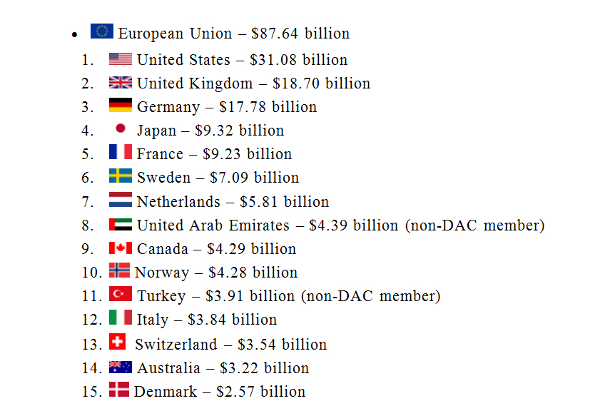
Countries by development aid given

Slide 28
Donor countries by percentage of gross national income (GNI )
The OECD also lists countries by the amount of ODA they give as a percentage of their gross national income. Seven countries met the longstanding UN target for an ODA/GNI ratio of 0.7% in 2015. The top 15 DAC and non-DAC countries for 2015 are shown below:

Slide 29
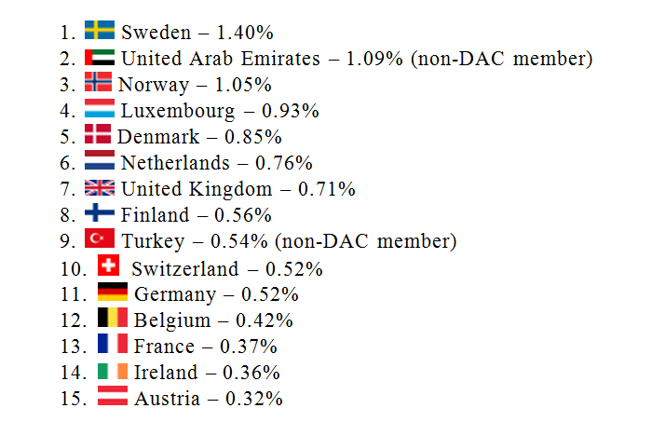
Donor countries by percentage of gross national income
The average for European Union countries that are DAC members – 0.47%

Slide 30
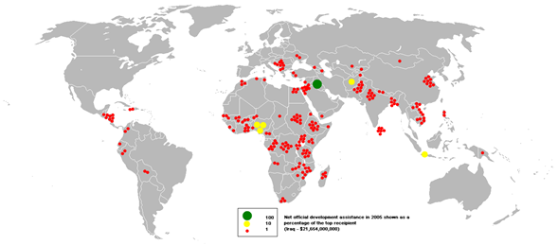
Aid recipients /rɪˈsɪpiənts/
The average for European Union countries that are DAC members – 0.47%

Slide 31
Aid recipients
World Bank reports that Iraq was the top recipient of development aid in 2005 followed by Nigeria. However, this is due to the significant debt relief deals that were granted to these nations that year - when donor countries write off a portion of a recipient country's debt, it is counted as official development assistance from the donor country.
The OECD reports that in 2009 Africa received the largest amount of ODA, at $28 billion. Of that, $25 billion went to countries south of the Sahara, with Sudan receiving approximately $1.9 billion and Ethiopia getting $1.8 billion. Asia received the second largest amount at $24 billion. The top ODA receiving countries in order were Afghanistan ($5.1 billion), Iraq ($2.6 billion) and Vietnam ($2.1 billion)

Slide 32
Criticism
Official development assistance has been criticized by several economists for being an inappropriate way of helping poor countries. The Hungarian economist Peter Thomas Bauer has been one of the most vocal of them. Another notable economist arguing against ODA includes Dambisa Moyo in her book Dead Aid. According to her, a country used to receiving ODA may be perpetually bound to depend on handouts.
Donor countries are most commonly compared by the amount of Official Development Assistance given and their quantity of aid as a percent of GDP. However, there is an increasing focus placed on the quality of aid, rather than simply the quantity. The Commitment to Development Index is one such measure that ranks the largest donors on a broad range of their "development friendly" policies. It takes into account the quality of aid, in addition to the quantity, penalizing countries for tied aid. Aid also does not operate in a vacuum; a country's policies on issues such as trade or migration also have a significant impact on developing countries.
Tied Aid: Viện trợ ràng buộc (Viên trợ có điều kiện)
Perpetually /pəˈpetʃuəli/ vĩnh viễn
Handout /ˈhændaʊt/ đồ cho miễn phí

Slide 33
7. Service sector project
Agricultural Services Sector Project
The Agricultural Services Sector Project addresses two main goals of the Government's new agricultural sector policy:-
improvement of cost-effectiveness of public expenditures in the agricultural sector and improvement of nutritional standards and incomes in rural areas.
-The project is a hybrid operation composed of a policy component and an investment component.
The policy component focuses on:
(1) reforming the agricultural input policy;
(2) reorganization of Buyenzi and Kirimiro Regional Development Companies (RDC)
(3) reforming the salary structure of the Ministry of Agriculture and Livestock (MOAL) staff.
The investment component comprises:
(1) strengthening of MOAL's central services;
(2) strengthening agricultural research;
(3) strengthening through reorganization of regional agricultural services;
(4) management of RDC reorganization;
(5) promotion of community development and rural youth employment; and
(6) strengthening of the cooperative movement.

Slide 34
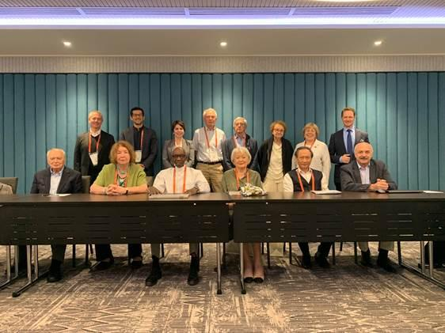
8. Scientific research project
Application of Scientific method to the investigation of relationships among natural phenomenon to solve a technical problem.
9. Environment-friendly projects.
Green - chemistry.

Slide 35
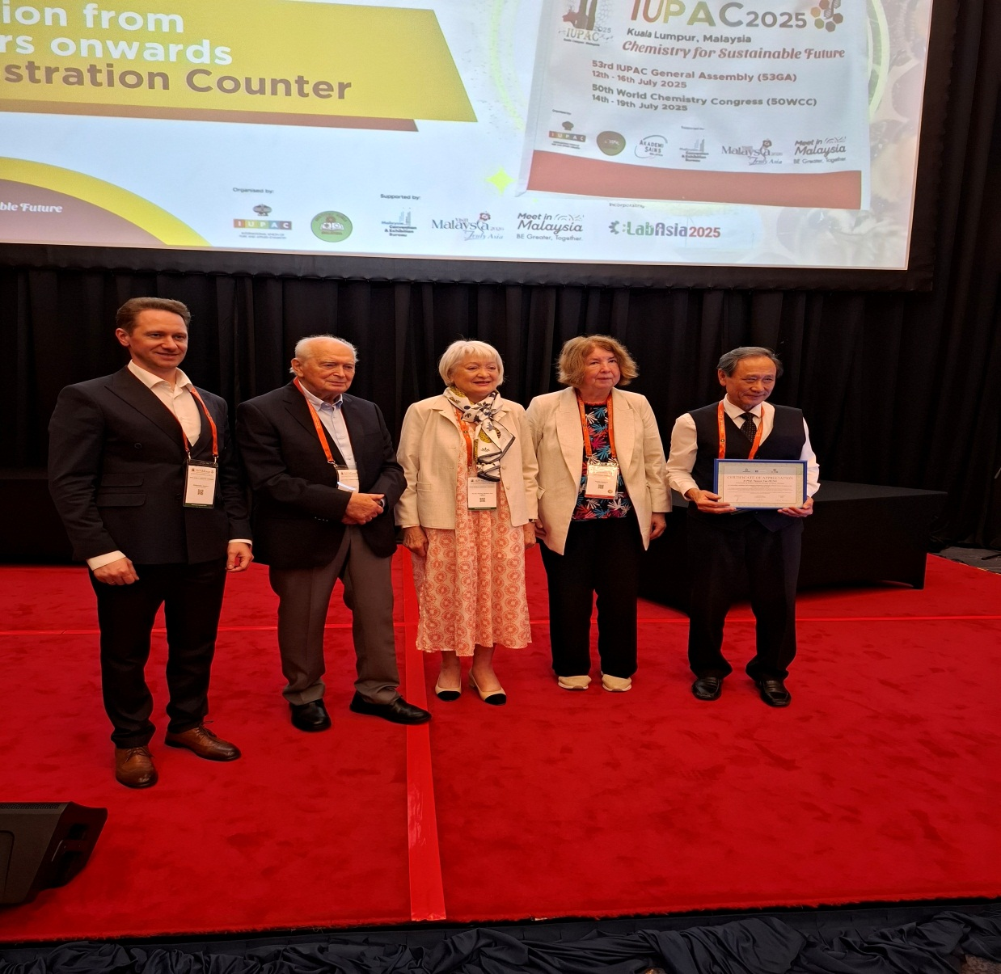
IUPAC JULY 2025 - Malaysia

Slide 36
10. According to scale and size
10.1. Mega project
A project involving huge investment and of relatively long duration (5 to 10 years) is called mega project. These projects require EIA. Example- Upper Karnali hydropower project.
10.2. Major project
It is smaller in size and also less complex than the mega project. Example- Middle Marshyangdi hydropower project.
10.3. Medium project
It is small in size than the major project. Examples- Khimti hydropower project. This project requires IEE (Initial Environmental Examination).
10.4. Small project
It is the smallest project in size and also of short duration. Example- Manang hydropower.
10.5. Micro project
It is smaller than the small project and managed by community-based organizations. Example - Ghandruk micro hydropower project.

Slide 37
11. According to time frame and speed
11.1. Normal project
Normal time allowed for project implementation.
11.2. Crash project
Saving in time is achieved by spending extra resources in terms of money, materials and manpower. ( task force)
Task force /ˈtɑːsk fɔːs/ a military force that is brought together and sent to a particular place . Đặc nhiệm .

Slide 38
12. According to nature
12.1. Simple project
Simple projects involve only one or a few people over a short time. Typically, simple projects will have few tasks dependent on other tasks, and will be relatively straightforward and easy to coordinate. Examples might be coordinating delivery of resources for a workshop session, implementing a small marketing plan, or delivering a simple software enhancement.
12.2. Complex project
Nearly all large and many small projects exhibit characteristics of complexity. Nevertheless projects of all sizes continue to be managed using linear thinking strategies based on project management traditions that go back to the building of the great pyramids in Egypt during the third millennium BCE, when societies and workgroups were arranged hierarchically. Much of the thinking dominating project management as it is currently practiced and taught is still founded upon control theories which were developed in the early modern period to deal with nineteenth- and twentieth-century industrialization and imperial expansion. There is nothing intrinsically wrong with this. However, issues do arise when these ideas are applied unilaterally to all kinds of projects in all contexts.

Slide 39
12.3. Innovative
Innovation is often also viewed as the application of better solutions that meet new requirements, unarticulated needs, or existing market needs. This is accomplished through more-effective products, processes, services, technologies, or business models that are readily available to markets, governments and society. The term "innovation" can be defined as something original and more effective and, as a consequence, new, that "breaks into" the market or society. It is related to, but not the same as, invention. Innovation is often manifested via the engineering process. The opposite of innovation is exnovation.
While a novel device is often described as an innovation, in economics, management science, and other fields of practice and analysis, innovation is generally considered to be the result of a process that brings together various novel ideas in a way that they affect society. In industrial economics, innovations are created and found empirically from services to meet the growing consumer demand.
12.4. Emergency
Emergency project is the work the organization and management of resources and responsibilities for dealing with all humanitarian aspects of emergencies – preparedness, response, and recovery – in order to reduce the harmful effects of all hazards, including disasters.

Slide 40
13. According to orientation
13.1. Product oriented project
The focus is on the technical part of the project. Examples-building, road, hydropower.
13.2. Process oriented
No consideration is given to technical part. Examples- person focused training, repair of cement plant etc.

Slide 41
REFRESHMENT (10 MIN.)
Continuation of Dr. Nguyen Tuong Lan

Slide 42
B . Representative Project Examples
1. University for Science and Technology of Hanoi (USTH)
The Bilateral project for Education and Training based on Intergovermental Agreement between Viet Nam and France:
“Establishment and Development of University for Science and Technology of Hanoi”

Slide 43
Where projects come from ?
Reasons to initiate a project:
1. From outside of the organization
•
Outside
Customer needs; market demands
•
Regulator and social requirements;
2. From inside of the organization
•
Business strategy or technology
advancement
•
Inside
Improve or fix products, processes, or
services.
Version 2.4 -All Rights Reserved © Professional Management Academy
www.pma.edu.vn
6

Slide 44


Slide 45
Bologna Process
The Bologna Process is an intergovernmental higher education reform process that includes 49 European countries and a number of European organisations, including EUA. Its main purpose is to enhance the quality and recognition of European higher education systems and to improve the conditions for exchange and collaboration within Europe, as well as internationally.
Launched in 1998-1999, the Bologna Process established goals for reform in the participating countries, such as the three-cycle degree structure (bachelor, master’s, doctorate), and adopted shared instruments, such as the European Credits Transfer and Accumulation System (ECTS) and the Standards and Guidelines for Quality Assurance in the European Higher Education Area (ESG).
When the European Higher Education

Slide 46
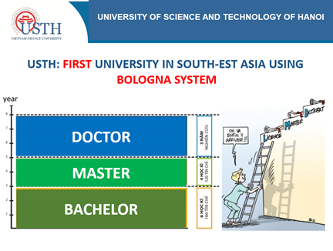

Slide 47
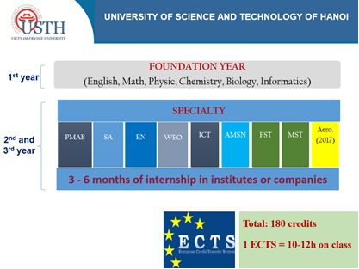

Slide 48
Academic year :2021-2022

Slide 49

Medical Science and Technology
Information and Communication Technology
Advanced Materials Science and Nanotechnology
Aeronautical Engineering
Applied Environmental Sciences
Space Science and Satellite Technology
Automotive Engineering
USTH’s degree Bachelor programs
Biotechnology-Drug discovery
Engineering Physics and Electronics
Electrical Engineering and Renewable Energy
Data Science
Mechatronics Engineering Technology
Chemistry
Cyber Security
Applied Mathematics

Slide 50

OUR UNIVERSITY

Slide 51
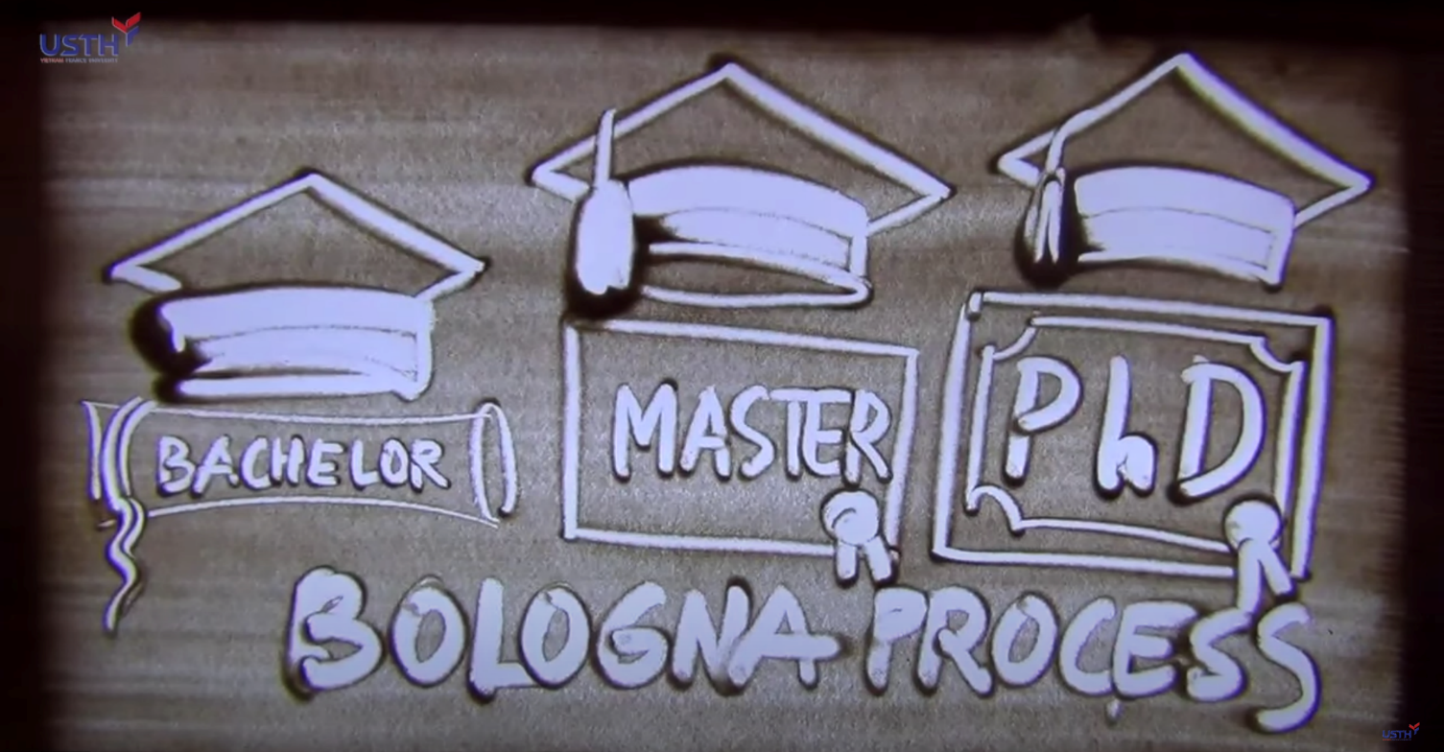
BOLOGNA PROCESS

Slide 52

PROGRAMS ( Specialities or majors)

Slide 53
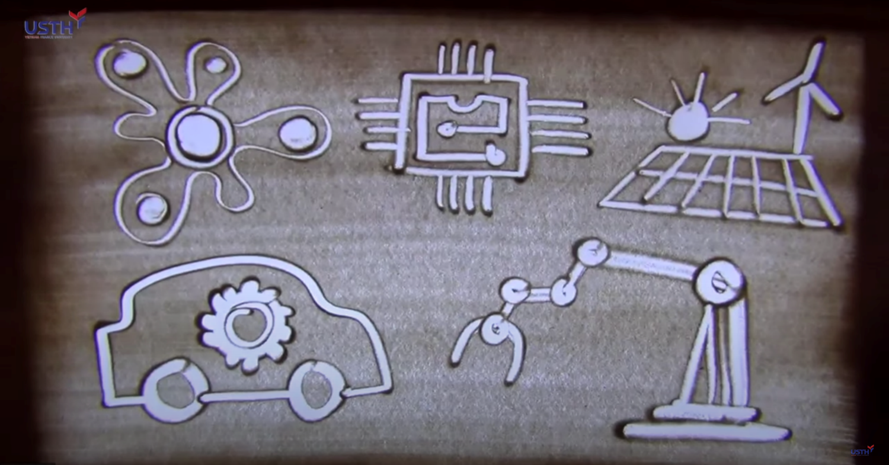
PROGRAMS (Specialites or Majors)

Slide 54
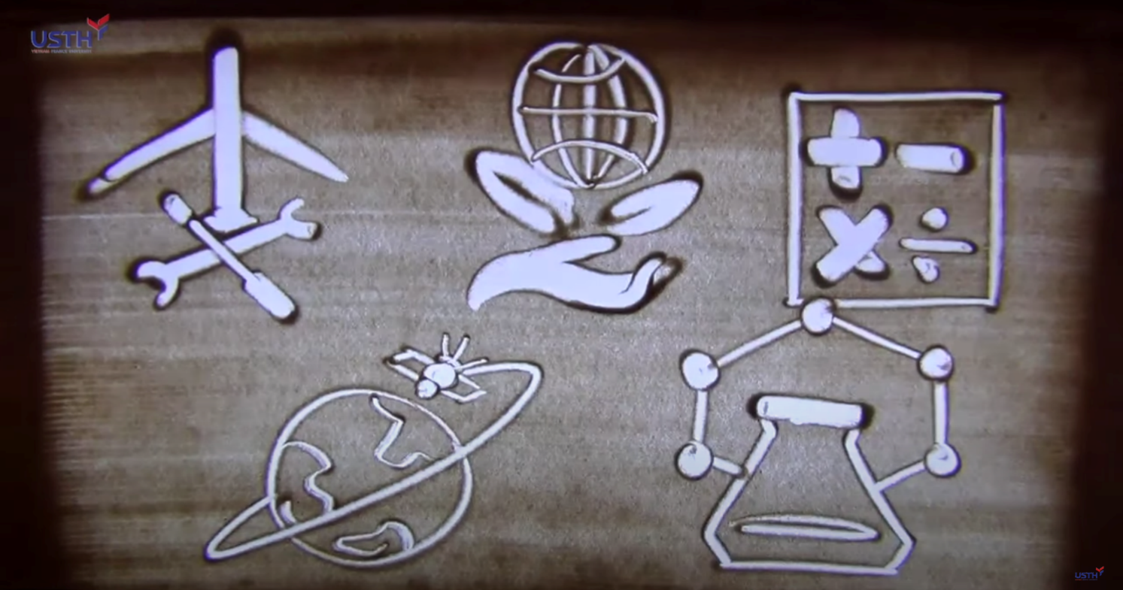
PROGRAMS ( Specialities or Majors )

Slide 55

OUR UNIVERSITY

Slide 56
Academic year 2024-2025

Slide 57

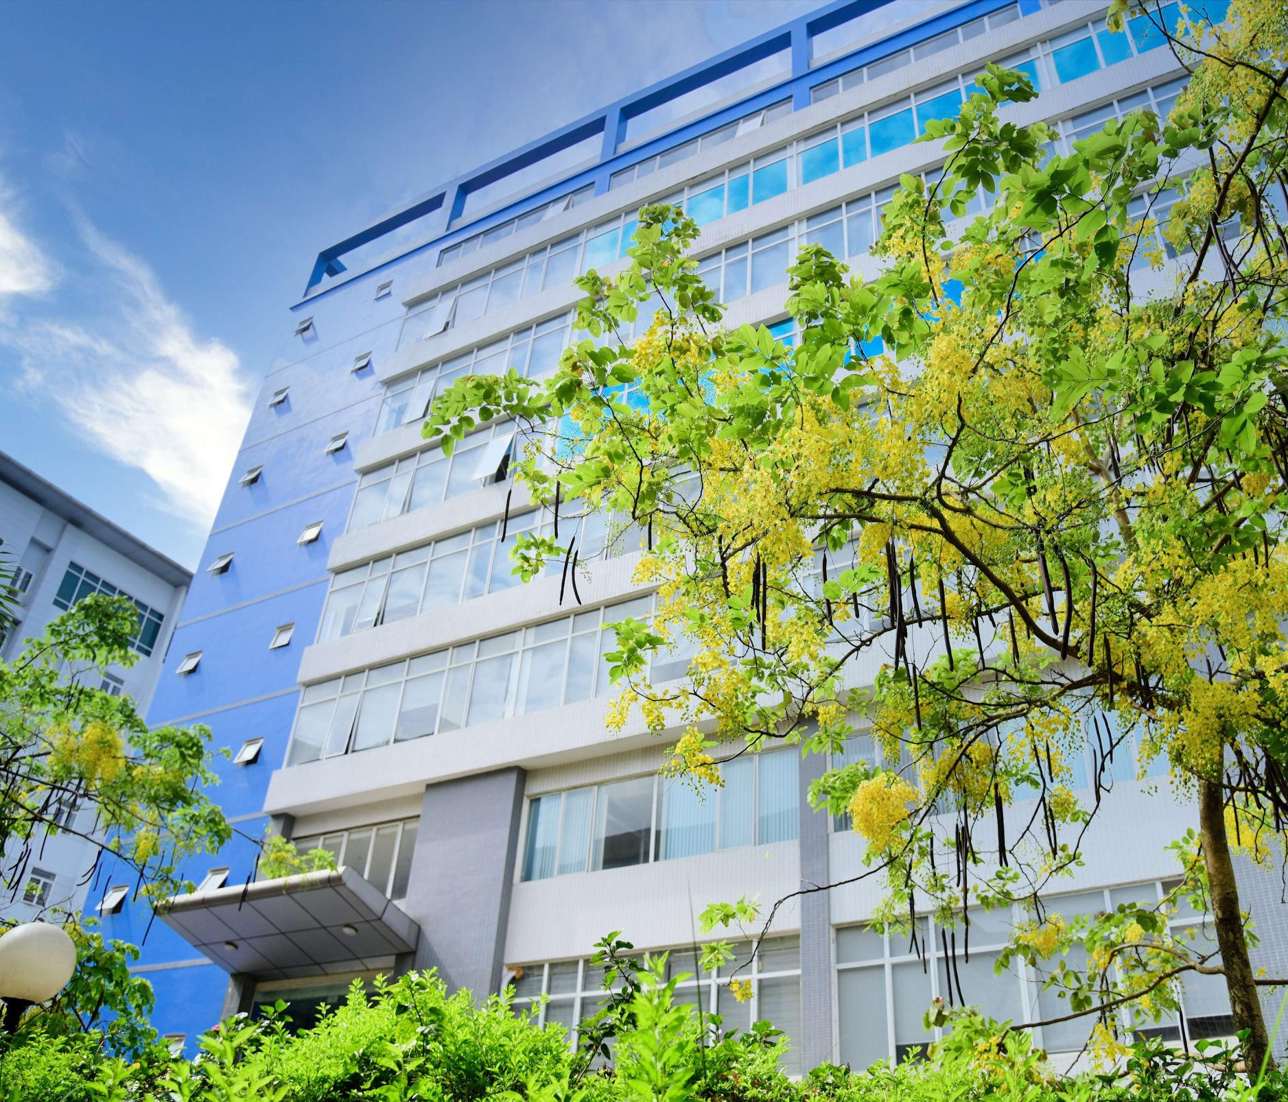
Exploring Opportunities in Institutional Autonomy in the context of the Vietnamese higher education system
Assoc. Prof. Dr. NGUYEN HAI DANG
Vice Rector
University of Science and Technology of Hanoi

Slide 58




Established in 2009 under the Intergovernmental Agreement between Vietnam and France
To train qualified human resources in the field of Science and Technology
Member of the Vietnam Academy of Science and Technology (VAST), the nation’s leading research institution
1

Slide 59
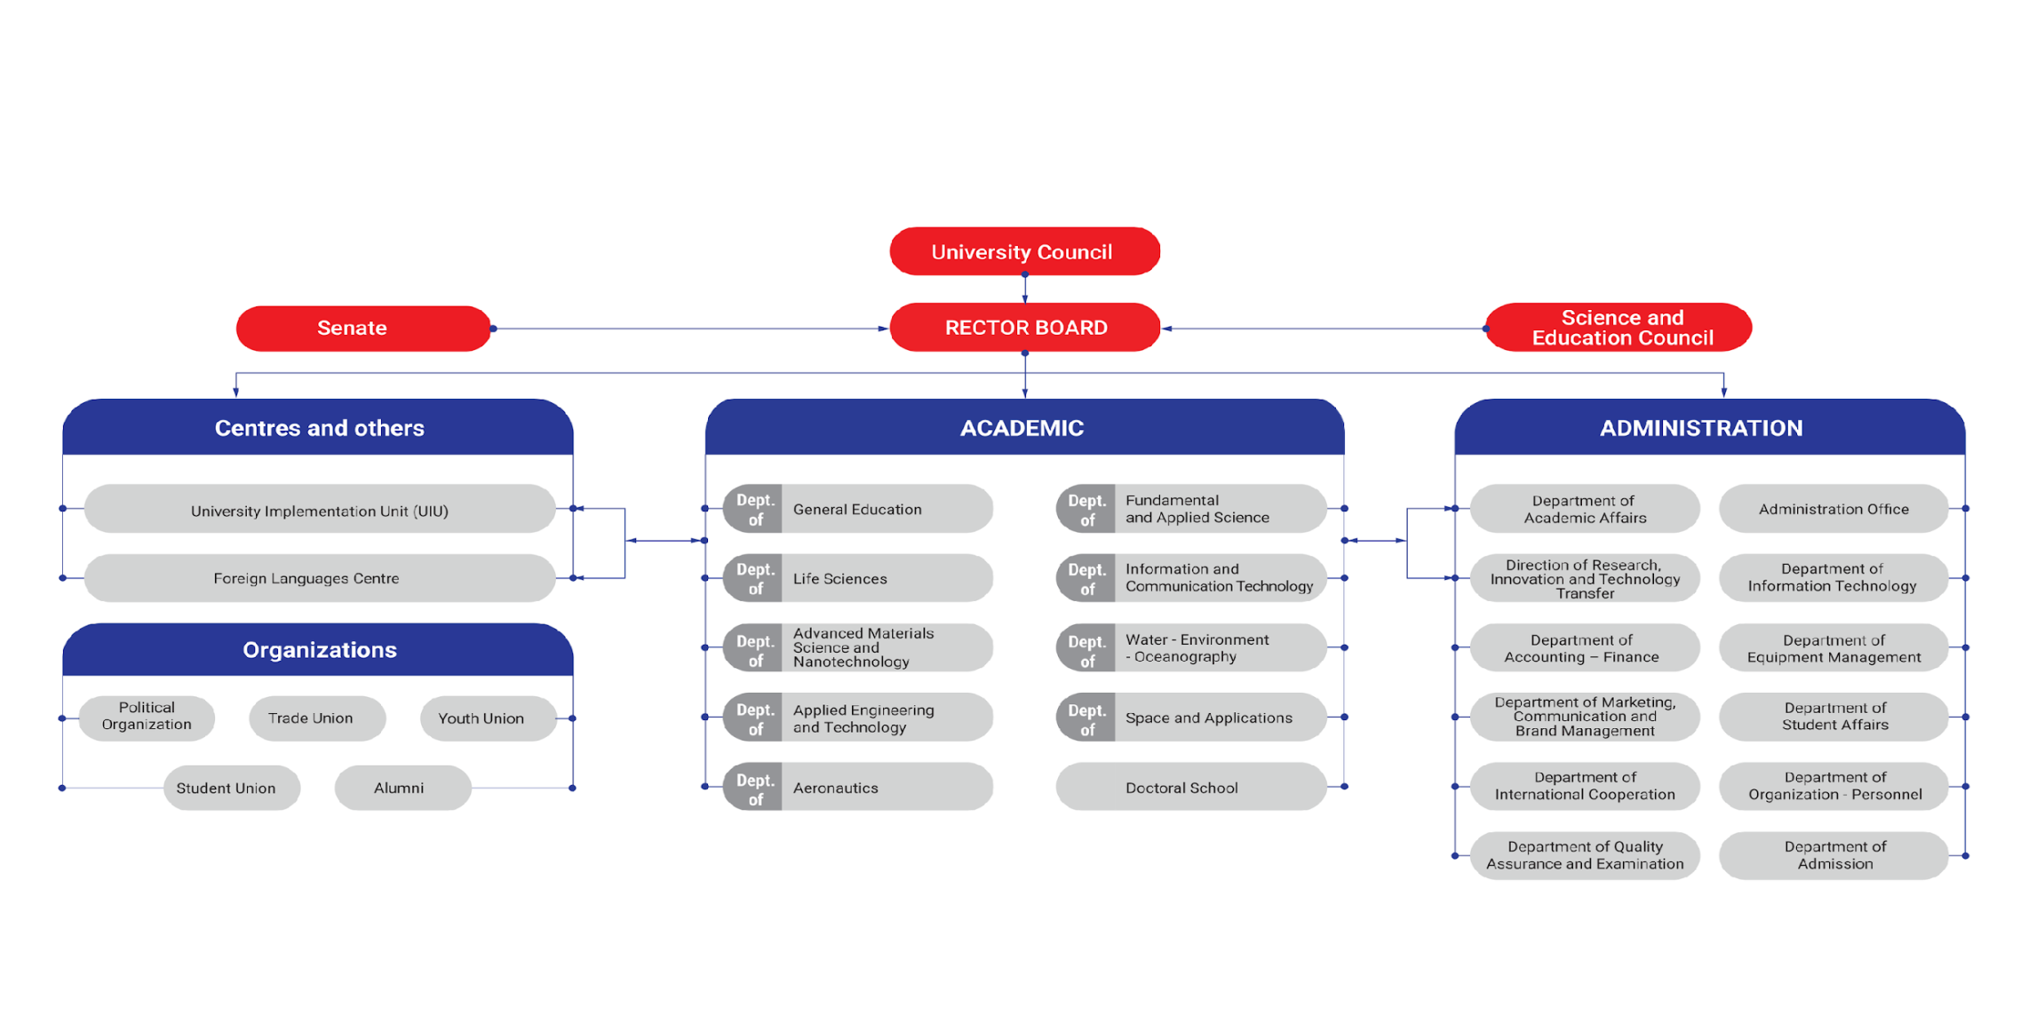
ORGANIZATION CHART
Coordination between Vietnam - France
3

Slide 60



Milestones
2009
2016
2018
Established under Intergovernmental agreement Vietnam - France
Moved under VAST
Intergovernmental agreement period II signed
2023
2020
2019
Institutionally accredited according by HCERES
The Prime Minister approved Intergovernmental Agreement for the next 5 years
10th Anniversary of USTH
2

Slide 61
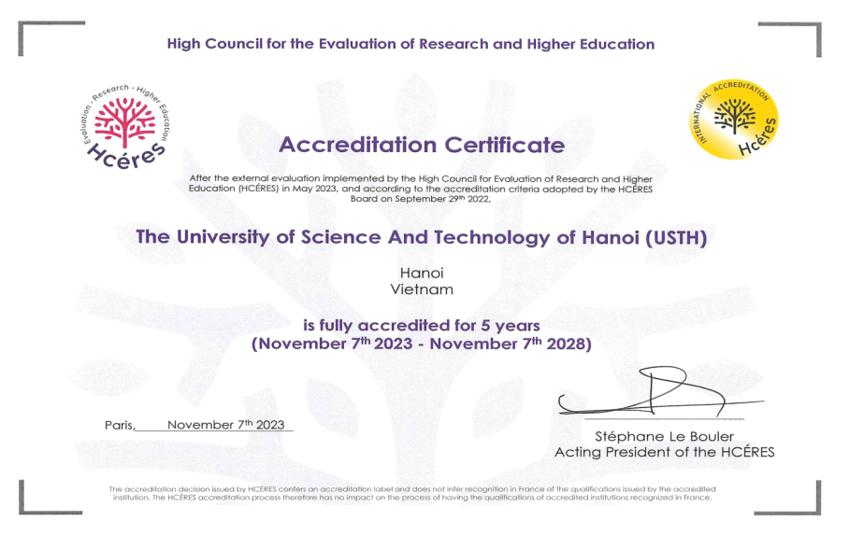
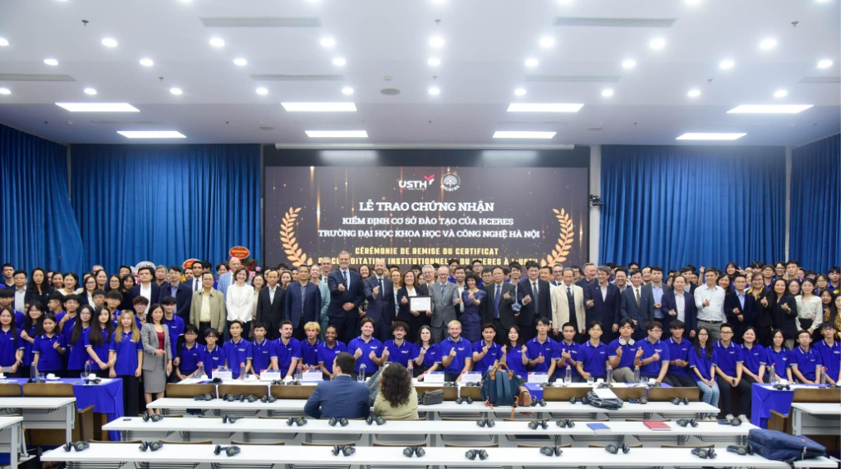
THE MOST SUCCESSFUL MODEL FRANCO-X UNIVERSITY IN THE WORLD
USTH received HCERES Accreditation Certificate in 2023
4

Slide 62
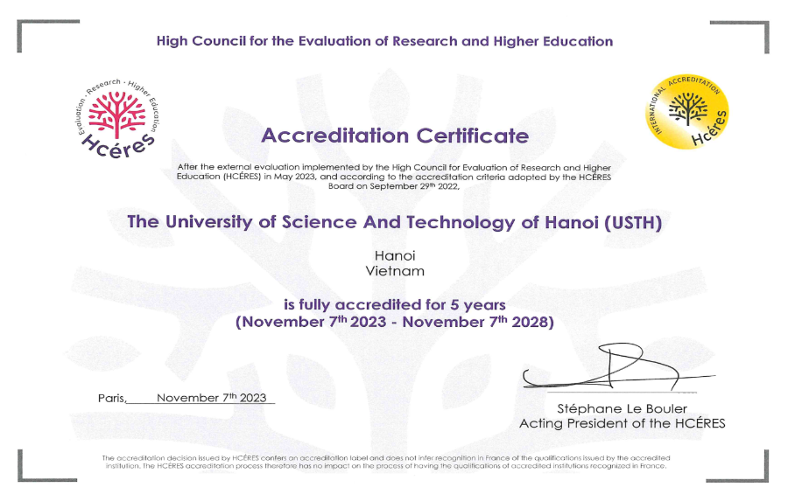
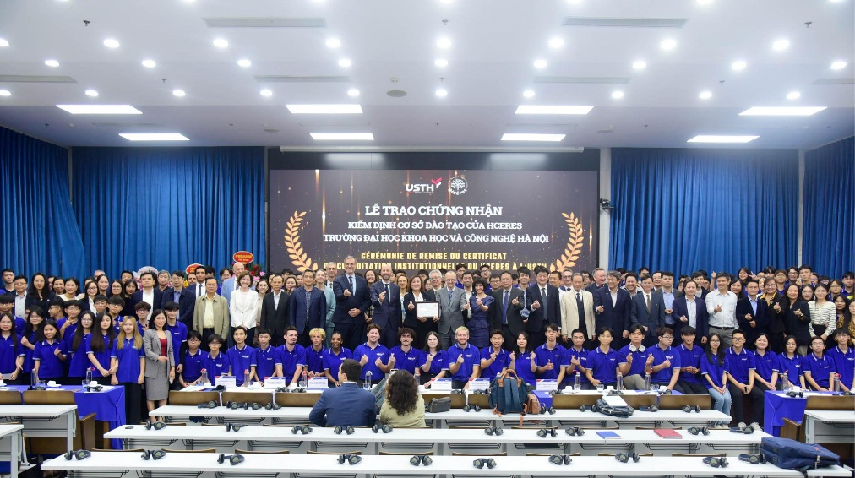
THE MOST SUCCESSFUL MODEL FRANCO-X UNIVERSITY IN THE WORLD
USTH received HCERES Accreditation Certificate in 2023
4

Slide 63








Bologna process (Bachelor – Master – Doctor in 3 -2 -3 years) and ECTS system
*
*
Training language: English
Supported by USTH Consortium - more than 30 French universities and institutes
*
Bachelor and Master training programs accredited by HCERES
*
WHY USTH?
Modern facilities and international standardized labs
*
5

Slide 64
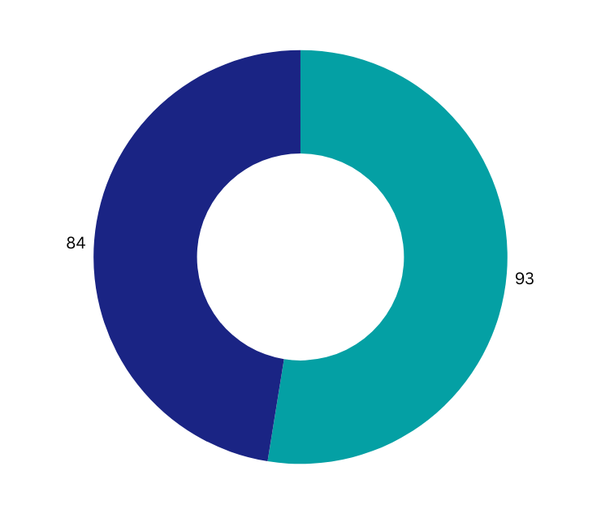



Student -
Academic Personnel
103
194
LECTURER - RESEARCHERS
> 3200
STAFF/
LECTURER-RESEARCHERS
89% PhD
11% Assoc.Prof
2.5%
STUDENTS
INTERNATIONAL STUDENTS
91
ADMINISTRATION OFFICERS
from France, Belgium, Germany,
USA, Thailand, Myanmar, etc.
>150
international lecturers/ year
7

Slide 65
Training
Open new programs
Regulations for the opening of new programs:
Decision No. 365/QĐ-ĐHKHCN dated June 07th, 2021 of USTH on the Issuance of Procedure on opening New Academic Program at Bachelor level.
Circular No. 02/2022/TT-BGDĐT dated January 18th, 2022 of the MOET on promulgating conditions and procedures for opening training programs, and suspension of training programs at bachelor’s, master’s and doctor’s levels.
Determine the market’s demands
Cooperation with French experts: from USTH Consortium and IRD (~53% teaching time of training program)
USTH Consortium - French Academic Institutions to supports USTH: more than 30 French universities and institutes.
Training programs meet the Government’s strategic training programs developments
8

Slide 66
Difference between a Major, Specialisation and Area of Study
Is there a difference between a major, specialisation and area of study?
A major is an official specialisation which will be recorded on an academic record or transcript, or reflected on official graduation documents. For example, if you have completed a Bachelor of Science with a major in genetics, your academic record will reflect the completion of a Bachelor of Science (Genetics).
A general specialisation or an area of study may be used interchangeably when referring to more comprehensive studies on a topic within a discipline. However, a general specialisation or area of study will not always be recorded on an academic record or transcript, or reflected on official graduation documents.

Slide 67
Information and Communication Technology
Life Sciences
Water - Environment - Oceanography
Aeronautics
-Biotechnology - Drug Discovery *
- Food Science and Technology
- Medical Science and Technology
-Pharmacy
- Aeronautical Engineering
- Information and Communication Technology *
- Cyber Security
- Data Science
- Applied Environmental Sciences
8
17
Academic Departments
Bachelor Programs
Space and Applications
Energy
Fundamental and Applied Sciences
Advanced Materials Science and Nanotechnology
- Electrical Engineering and Renewable Energy
- Mechatronics Engineering Technology
- Automotive Engineering
- Space science and Satellite Technology
- Chemistry *
- Applied Mathematics
- Engineering Physics and Electronics
- Advanced Materials Science and Nanotechnology
(*Red) Double Degree programs in cooperation with French Universities
9

Slide 68


1. Giới thiệu bản thân
1. Giới thiệu bản thân
6 Master programs
7 PhD programs
  Double Degrees by USTH and a French University
  50% International lecturers from French partners
  3 - 6 months internship
  3 years (Master graduates) or 4 years (Bachelor graduates)
  Co-superviser for PhD students
  Sandwich Model with ½ time in Vietnam và ½ time in France
10

Slide 69


KEY RESEARCH GROUPS
  PHYTOMED - PhytoMedicine
  BEAM - Biopharma-Environmental Assessment & Monitoring
  SEED - Sustainable Energy and Environmental Developmen﻿t
  CECS - Chemistry for Energy Conversion and Storage
  REMOSAT - Research group for Remote sensing and Modelling of Surface and Atmosphere
  AMA - Advanced Materials and Applications
INTERNATIONAL JOINT LABS
  LMI DRISA - Laboratoire Mixte International “Drug Resistance in Southeast Asia”
  LMI LOTUS - Laboratoire Mixte International “Land Ocean aTmosphere coUpled System”
11

Slide 70









Canada
Swedish
Belgium
Lithuania
Ireland
Germany
USA
Austria
Japan
France
South Korea
Italia
PACIFIC OCEAN
ATLANTIC OCEAN
Taiwan
Puerto Rico
Thailand
Vietnam
Philippines
Singapore
PACIFIC OCEAN
INDIAN OCEAN
Australia
Hosting countries for USTH internships
13

Slide 71
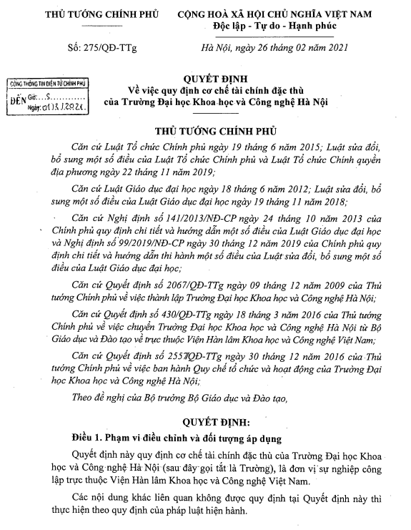
1. Giới thiệu bản thân
1. Giới thiệu bản thân
Decision No.275/QD-TTg
IMPACTS
  Regulations on specific financial mechanism of USTH
  Financial resources: Funds provided by the state budget, career revenues, grants, aid (excluding ODA and foreign non-governmental aid)...
  Autonomy in using financial resources
  Asset and financial management
1. Giới thiệu bản thân
DIFFICULTIES
  Human resources: Difficult to count French colleagues from Consortium as human resources for USTH
  Income does not perfectly attract high-quality employers even using the special financial mechanism
  MOET report: some templates are not customized for model universities
15

Slide 72
SUGGESTIONS
1. Giới thiệu bản thân
  Human resources: consider French colleagues from Consortium as human resources for USTH
  Income should attract high-quality employers by the special financial mechanism
  MOET report: some templates should be customized for model universities
16

Slide 73
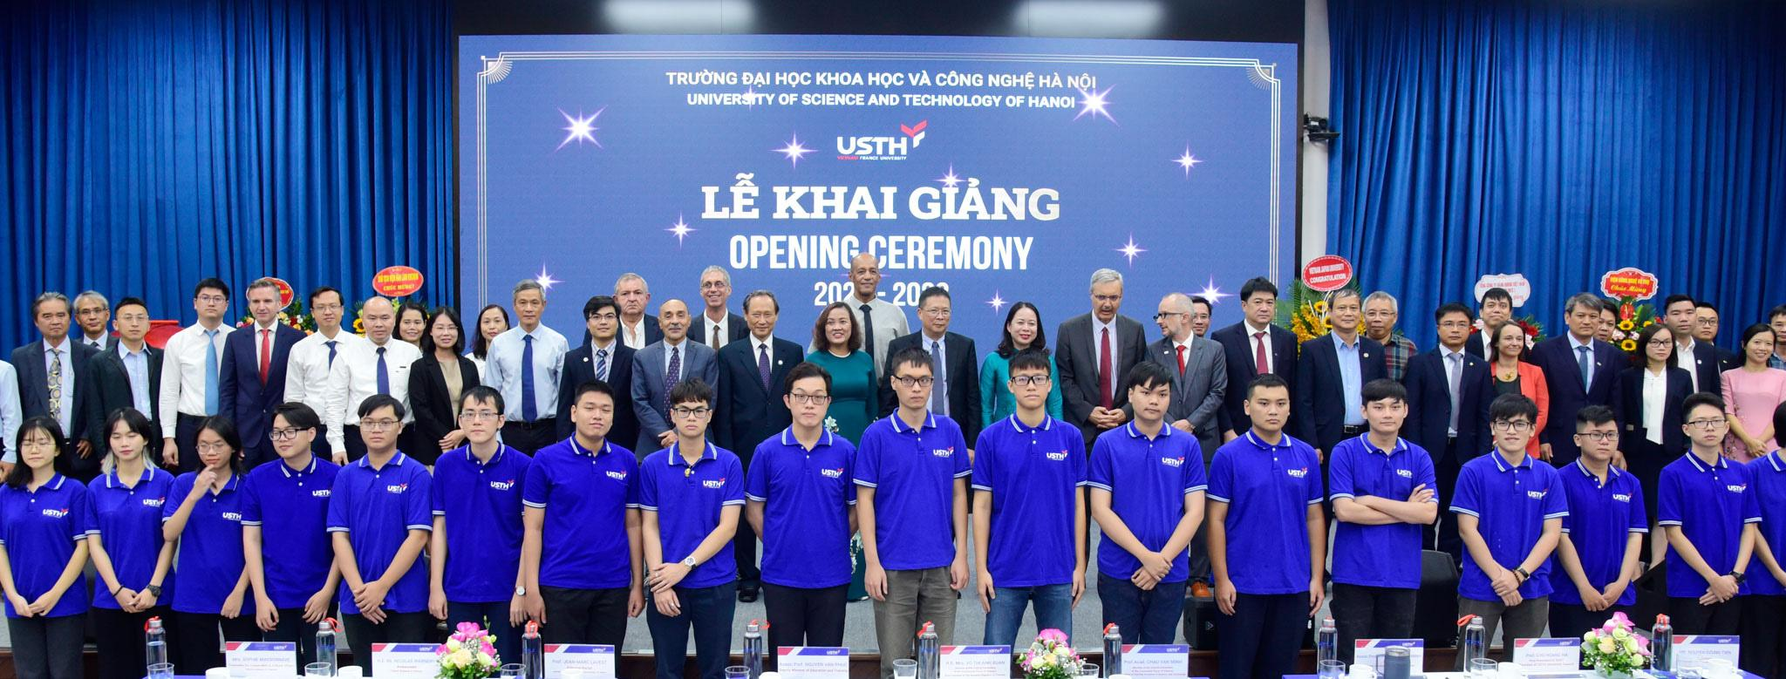
Thank you!

Slide 74
2. Loan project ADB–
BASIC DATA
Project Title: University of Science and Technology of Hanoi Development (New Model University) Project Borrower: the Government of Vietnam Executing Agency: Ministry of Education and Training Implementing agency: PMU-USTH and UIU Total Estimated Project Cost: US$213.0 M Financing Plan: OCR: US$ 170.0M ADFHT: US$ 20.0M Government Fund: US$ 23.0M | Loan Number: 2750/2751-VIE Loan Approval Date: 25 April 2011 Loan Agreement Signing Date: 10 November 2011 Loan Effectiveness: 1st March 2012 Original Loan Closing Date: 30 June 2018 Revised Loan Closing Date: None Elapsed Loan Period: 54 months Date of last ADB Review Mission: 19 – 27 Oct 2015

Slide 75
2. Loan project ADB - BASIC DATA
- The ADB agreed to provide a loan of $170 million from ADB’s ordinary capital resources (OCR) and a loan of $20 million from the hard terms facility of the Asian Development Fund (ADFHT) to finance the project.
- The OCR loan will have a 26-year term, including a grace period of 6 years, an annual interest rate determined in accordance with ADB’s London interbank offered rate (LIBOR)-based lending facility,a commitment charge of 0.15% per annum on any undisbursed amount of the loan, and such other terms and conditions as set forth in the draft loan agreement.
- The ADFHT loan will have a 32-year term, including a grace period of 8 years, an interest rate of 2.02% per annum throughout the life of the loan, and such other terms and conditions as set forth in the draft loan agreement. The Government committed to allocate $20 million as counterpart fund to cover Project operation and taxes and duties, plus $3 million for resettlement and land acquisition costs.

Slide 76
2. Loan project ADB–BASIC DATA
Output A: Effective Management and Governance System for the USTH.
Output A will assist in the development and implementation of the rigorous management and governance systems, capacity building programs for USTH senior managers and governors, university management and administrative systems and student services.
Output B: Systems to Promote High Quality and Relevance in Academic Programs at USTH Developed and Implemented.
Output 2 will establish and support the operation of a number of centers within the USTH that will promote high quality and relevance in academic programs at the USTH:
rigorous /ˈriɡ(ə)rəs/ Sự chặt chẽ , sự khắc khổ

Slide 77
2. Loan project ADB–BASIC DATA
Center for teaching and learning excellence. This will prepare graduate students to be university teachers and improve the teaching and curriculum development competencies of existing teachers.
Center for quality assurance. This will embed a permanent internal quality assurance management service for USTH management and academic staff by, among other things, establishing a quality assurance framework and institutionalizing the use of peer review and other strategies.
Center for research support. The center will provide USTH staff with high-level support in designing and publishing their research, applying for grants, and providing training in research strategies to postgraduate students.

Slide 78
2. Loan project ADB-BASIC DATA
Center for industry engagement. The center will be responsible for building links with industry and other potential users of USTH’s knowledge, expertise, and technologies. It will support researchers to establish industry links, develop joint research programs and contract research, and facilitate student placements, staff exchanges, and joint funding of infrastructure and services.
Center for laboratory management. The center will develop a centralized workshop system for the maintenance and repair of USTH’s scientific laboratories and build the capacity of technical staff to sustain an international standard science and technology university.

Slide 79
2. Loan project ADB–BASIC DATA
Output C: Physical Facilities at University of Science and Technology of Hanoi Constructed and Outfitted.
Output 3 will support the design, construction, and outfitting of the USTH physical facilities at the HHTP to support the university’s initial design capacity of 5,000 students. This will include site preparation, and design and construction of teaching spaces, research laboratories, dormitories, student leisure facilities, administration buildings, infrastructure, and provision of furniture, fittings, and equipment. Construction will use a design–bid–build approach.
Output D: Effective Project Management and Implementation.
Output 4 will support the establishment of systems and staff capacity required for effective project management and implementation. Procurement for the construction of the campus under output 3 will be managed by the central project management unit (PMU-USTH), while the university implementation unit (UIU) will manage the implementation of USTH’s development (Outputs 1 and 2). The PMU-USTH will manage the development and implementation of a project monitoring and evaluation system, including preparation of required plans, data systems, and baseline studies.

Slide 80
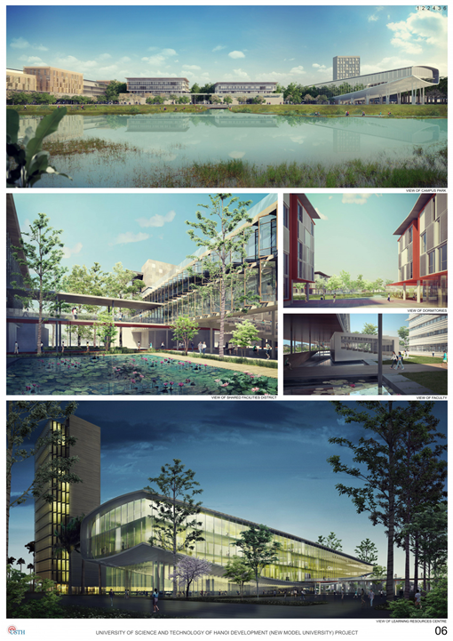
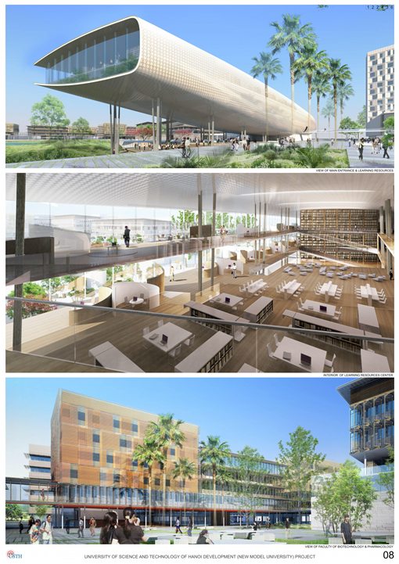
Hoa Lac Campus

Slide 81
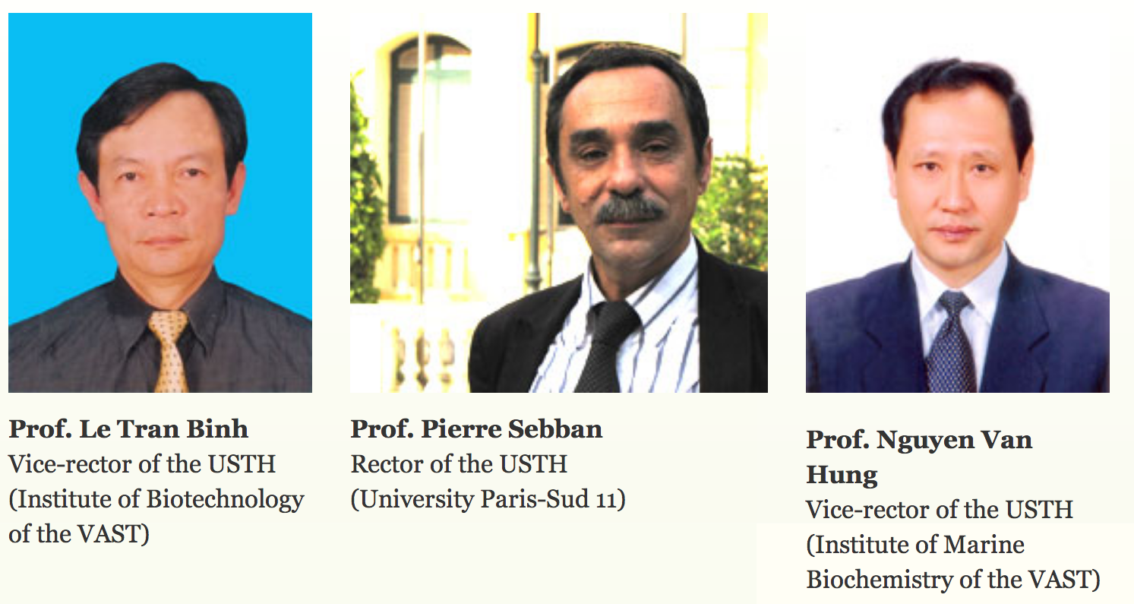
TRƯỜNG ĐẠI HỌC KHOA HỌC VÀ CÔNG NGHỆ HÀ NỘI
BAN GIÁM HIỆU NHÀ TRƯỜNG
NHIỆM KỲ 2010 - 2014
BAN GIÁM HIỆU NHÀ TRƯỜNG
Prof. Le Tran Binh
Vice-rector of USTH
Institute of
Biotechnology – VAST
Prof. Pierre Sebban
Rector of USTH
University Paris-Sud
Prof. Nguyen Van Hung
Vice-rector of USTH
Institute of Marine
Biochemistry – VAST
June /2010

Slide 82
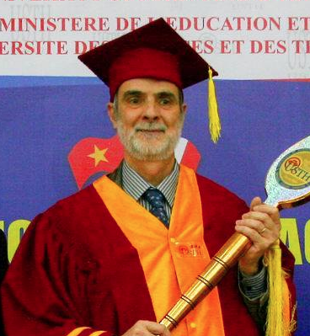
TRƯỜNG ĐẠI HỌC KHOA HỌC VÀ CÔNG NGHỆ HÀ NỘI
BAN GIÁM HIỆU NHÀ TRƯỜNG
NHIỆM KỲ 2015 - 2020
BAN GIÁM HIỆU NHÀ TRƯỜNG
Prof. Le Tran Binh
Vice-rector of USTH
Institute of
Biotechnology – VAST
Prof. Patrick Boiron
Rector of USTH
University of Lyon
Prof. Nguyen Van Hung
Vice-rector of USTH
Institute of Marine
Biochemistry – VAST
THÁNG 1/2015

Slide 83
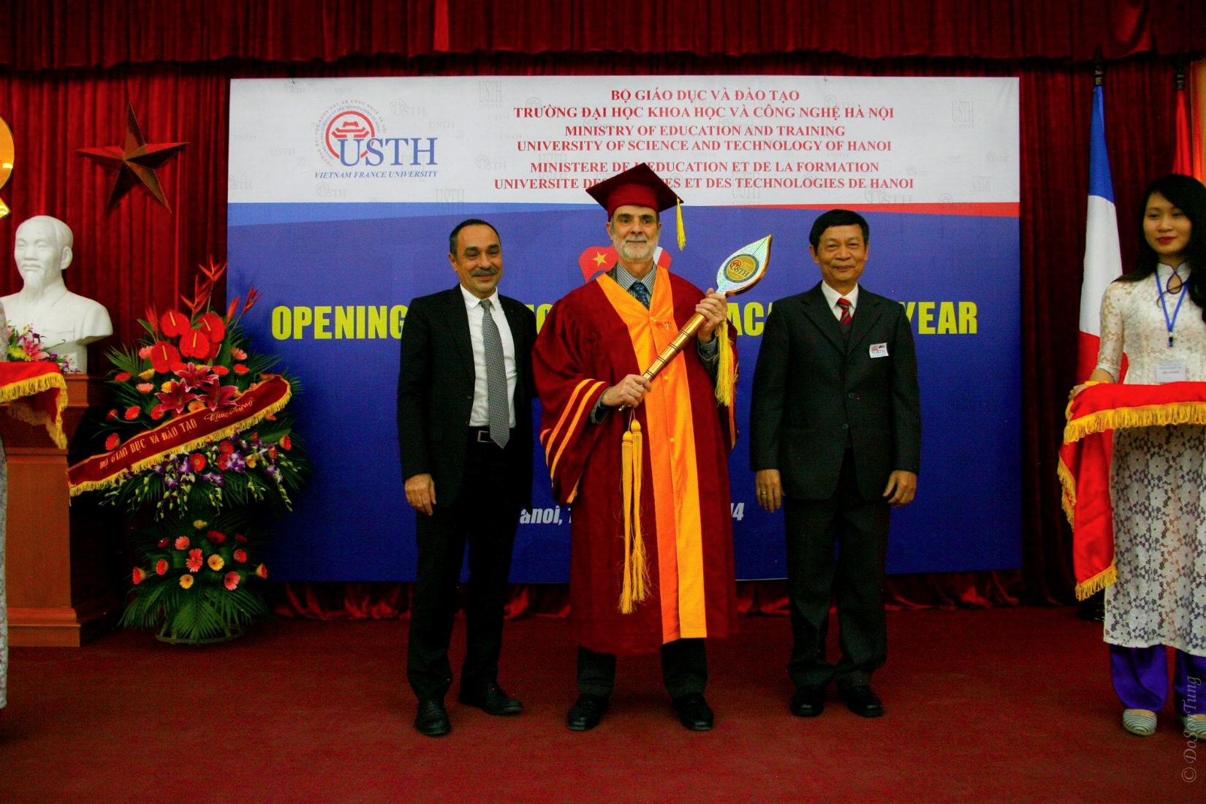
TRƯỜNG ĐẠI HỌC KHOA HỌC VÀ CÔNG NGHỆ HÀ NỘI
KHAI GIẢNG NĂM HỌC 2014 – 2015

Slide 84




USTH Rector Board
2017 - 2018
Prof. Patrick Boiron Rector (2015-2018)
Assoc. Prof. Dinh Thi Mai Thanh
Vice Rector (2016-2018)
Assoc. Prof. Ngo Duc Thanh
Vice Rector (2016-2018)

Slide 85

USTH Rector Board
2018
Assoc. Prof. Dinh Thi Mai Thanh
Acting Rector (2018 – 2019)
Dr. Nguyen Hai Dang
Vice Rector (2018 – up to now)

Slide 86


USTH Rector Board
2019 - 2021
Prof. Etienne Saur
Principal Rector (2019-2021)
Assoc. Prof. Dinh Thi Mai Thanh
Rector (2019-up to now)
Dr. Nguyen Hai Dang
Vice Rector (2018 – up to now)

Slide 87


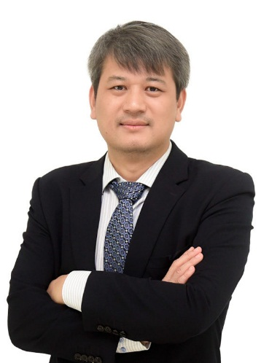
USTH Rector Board
2022
Prof. Jean-Marc Lavest
Principal Rector (2021-up to now)
Assoc. Prof. Dinh Thi Mai Thanh
Rector (2019-up to now)
Dr. Nguyen Hai Dang
Vice Rector (2018 up to now)
Assoc. Prof. Tran Dinh Phong
Vice Rector (2022-up to now)

Slide 88
Law basis
Intergovernmental agreement between the Government of Vietnam and the Government of France University of Science and Technology of Hanoi (USTH) construction and development for the period 2009 - 2019
Agreement between the Government of Vietnam and the Government of France on the development of University of Science and Technology of Hanoi, effective from 2020
Decision No. 2557/QĐ-TTg of the Prime Minister on promulgating the regulation on organization and operation of USTH
Decisions of the Rector of USTH on assigning duties for Principal Rector, Rector and Vice Rectors.

Slide 89
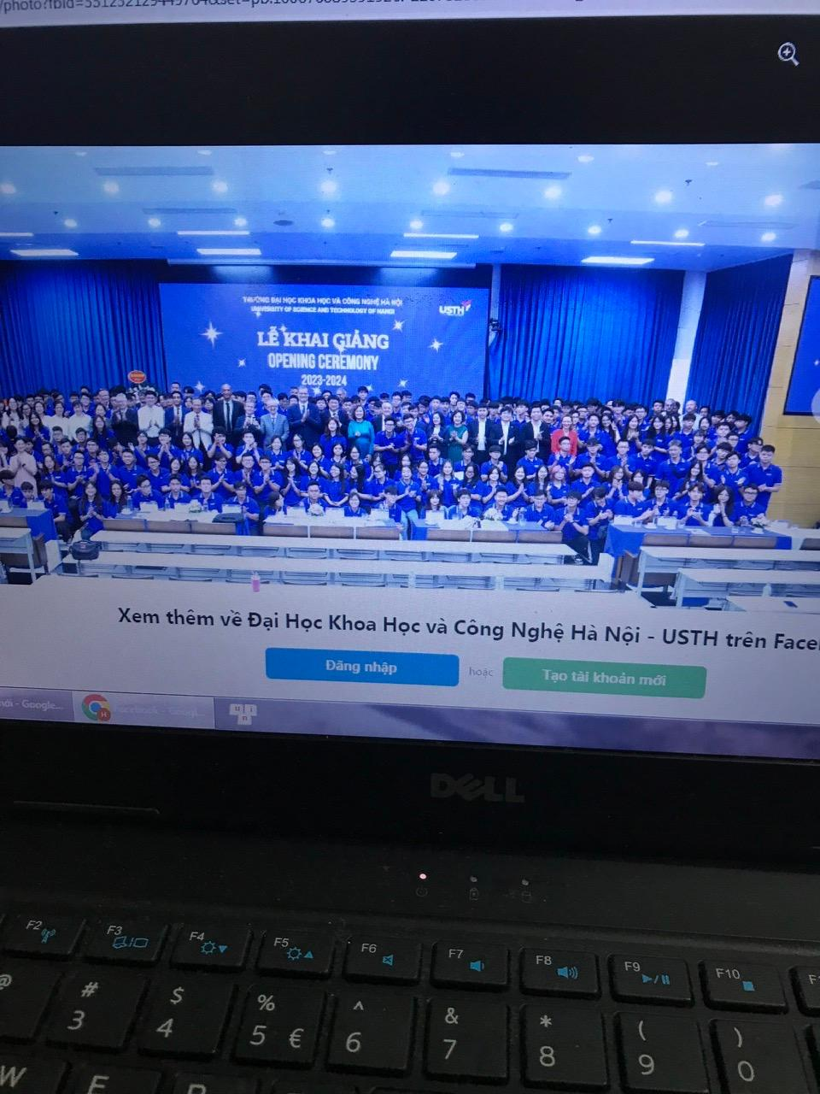

Slide 90
Duties among the Rector Board
The Principal Rector and the Rector are the leaders in all operations, take full responsibility before the law, the President of VAST and the University Council for aspects which they are assigned;
The duty assignment for the Principal Rector and the Rector shall be based on each one’s strength
The Vice Rectors shall perform their tasks as assigned or authorized by the Principal Rector and the Rector, be responsible before the law and the Principal Rector/the Rector for their assignments. Vice Rectors shall regularly and timely report on the implementation of the assigned tasks and ask for the directions of the Principal Rector, the Rector on important and complicated issues before making any decisions;

Slide 91
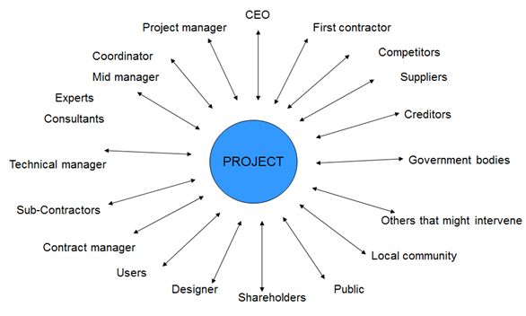
Project Stakeholders
“Project stakeholders are individuals and organisations who are actively involved in the project, or whose interests may be positively or negatively affected as a result of project execution or successful project completion”.

Slide 92
STAKEHOLDERS of USTH Project stakeholder/ˈsteɪkhəʊldə(r)/
The Government of Vietnam
France
- Ministry of education and training of Vietnam
- Vietnam Academy of Science and Technology
- Ministry of National education of France
Ministry of National security
USTH PROJECT
Rectorboard
Ministry of Finance
French Consortium
Ministry of Labour invalids and Social affairs

Slide 93
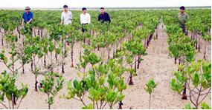
3. Disaster Prevention Project in Vietnam
Disaster prevention through mangrove afforestation Contributing to protection of the Earth’s environment
Mangroves, which grow in marshy places, are called a ‘green wall’, protecting people from natural disasters such as typhoons and tsunami. The Japanese Red Cross Society (JRCS), has worked with the Vietnam Red Cross Society (VRCS), since 1997 to promote the afforestation of mangroves and other plants and on various environmental protection activities, covering about 10,408 hectares, which is equal to about 2226 Tokyo Domes.
. These forests are estimated to absorb about 16.3 million tons of greenhouse gas and thus contribute to the prevention of global warming.

Slide 94
3. Disaster Prevention Project in Vietnam
Disaster prevention through mangrove afforestation Contributing to protection of the Earth’s environment
‘- We have come to live safely.’‘Mangrove’ is the general term for various types of plants growing in brackish (a mixture of fresh and salt) water. Mangrove forests were once numerous in Vietnam due to its rich environment. But war, deforestation, and shrimp farming have reduced the number by half. As a result, damage due to typhoons and tidal conditions has grown year by year, gravely affecting the lives of local people and their crops.
- A disaster prevention project promoting mangrove afforestation was launched by the JRCS and VRCS to address this problem. Afforestation is carried out by hand of local people, and a wide range of activities aimed at forest protection and fire prevention enlightenment by local volunteers have been undertaken.

Slide 95
3. Disaster Prevention Project in Vietnam
Disaster prevention through mangrove afforestation Contributing to protection of the Earth’s environment
Hoan Ruon, vice chairman of the Red Cross branch in Hai Phong City, which is one of the project targets, looked back at the fruits of these activities over the past 20 years and said, ‘Although it has been very hard to attract volunteers, all of the members enthusiastically tackled their assignments. As a result, they have contributed to a reduction in climate change and the disasters it brings.’
Bui An Bien in Thai Binh province, who took part in the afforestation activities from the beginning of the project, said in joy, ‘Afforestation led to a safe life. Mangroves are a good environment for fish and other types of seafood, so we could start aquafarming.
Mangrove afforestation in Vietnam has been supported by the JRCS for 20 years. The initial target was six northern provinces. It has since been enlarged to ten provinces. The VRCS makes a strong effort to cooperate with the government to promote future support from the government.

Slide 96
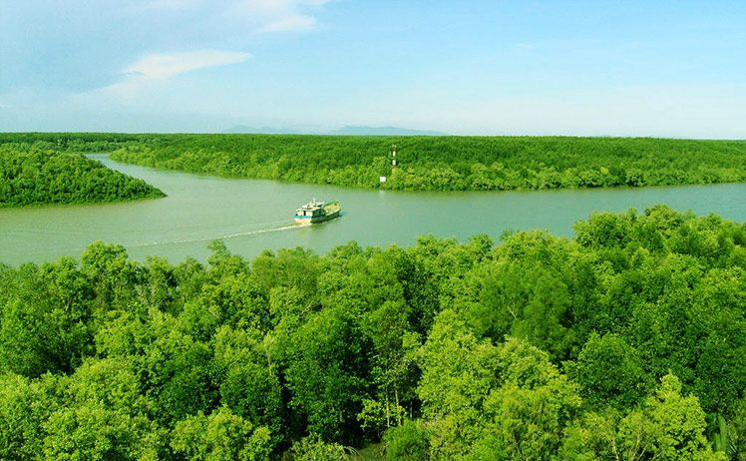
Can Gio Mangrove biosphere reserve

Slide 97
Vietnam Government Program
People with revolutionary contributions are supported with house construction and repair costs
Hơn 334.000 căn nhà đã được hỗ trợ xây mới, sửa chữa trên toàn quốc
(Chinhphu.vn) - Theo tổng hợp báo cáo từ 34 địa phương và các cơ quan liên quan, đến hết ngày 17/8/2025, cả nước đã hỗ trợ tổng cộng 334.234 căn nhà cho các đối tượng chính sách và hộ dân khó khăn về nhà ở.

Slide 98
Phong Châu Bridge
Công trình được khánh thành vào ngày 28 tháng 7 năm 1995. Vào ngày 9 tháng 9 năm 2024, cầu Phong Châu cũ đã bị sập. Phần đường xe chạy 7m, lề người đi mỗi bên 1m; bề rộng mặt cầu 9,5m. Cầu gồm 8 nhịp, trong đó hai nhịp 6 và 7 được chế tạo từ hai nhịp giàn giản đơn 64m do Bulgaria chế tạo.

Slide 99
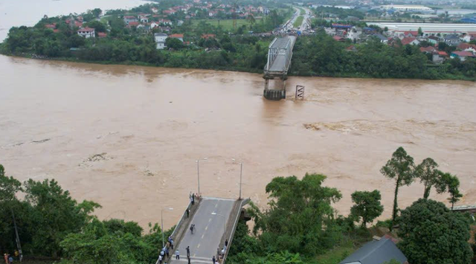

Slide 100
PHONG CHAU BRIDGE
Phong Chau Bridge inaugurated after nine months of emergency construction
Sunday, 16:21, 28/09/2025
VOV.VN - The Ministry of Construction and the People’s Committee of Phu Tho province on September 28 inaugurated and opened to traffic the new Phong Chau Bridge on National Highway 32C.
Construction of the new bridge began on December 21, 2024, and was completed three months ahead of schedule. The bridge is more than 652 meters long and 20.5 meters wide, designed with four traffic lanes. The project had a total investment of over VND635 billion and was managed by the Thang Long Project Management Board under the Ministry of Construction.

Slide 101
Cầu Phong Châu khánh thành 9/2025

Slide 102
Questions for preparation of midterm test anf final examination
1 . Why do we have to study project management ?
2 . Definition of the Project ?
3-which are characteristics of a project ?
4-The reasons for Project Failure and Success ?
5-How to classify the projects ?
6-What is ODA ;NGOs ?
7-How to prepare a project ( how many steps are there ) ?
8-Give Project Examples ?
9- How do you understand the “ Term ” Project Stakeholders : CEO…

